Slide 1
CH25 Web Security
Zonghua Gu
2017, ZJU
Notes:
This chapter provides an overview of computer security. We begin with a discussion
of what we mean by computer security. In essence, computer security deals
with computer-related assets that are subject to a variety of threats and for which
various measures are taken to protect those assets. Accordingly, the next section of
this chapter provides a brief overview of the categories of computer-related assets
that users and system managers wish to preserve and protect, and a look at the
various threats and attacks that can be made on those assets. Then, we survey the
measures that can be taken to deal with such threats and attacks. This we do from
three different viewpoints, in Sections 1.3 through 1.5. We then lay out in general
terms a computer security strategy.
The focus of this chapter, and indeed this book, is on three fundamental
questions:
1. What assets do we need to protect?
2. How are those assets threatened?
3. What can we do to counter those threats?

Slide 2
Outline
Overview of Web and security vulnerabilities
Cross Site Scripting
Cross Site Request Forgery
SQL Injection
Notes:
The Web is an extension of our computing environment because most of our daily tasks involve interaction with the Web.
In this lesson we will first review how the Web works, that is, how the browser interacts with websites, and the major thr eat vectors.
We will then discuss several attacks: cross site scripting, cross site request forgery, and SQL injection

Slide 3
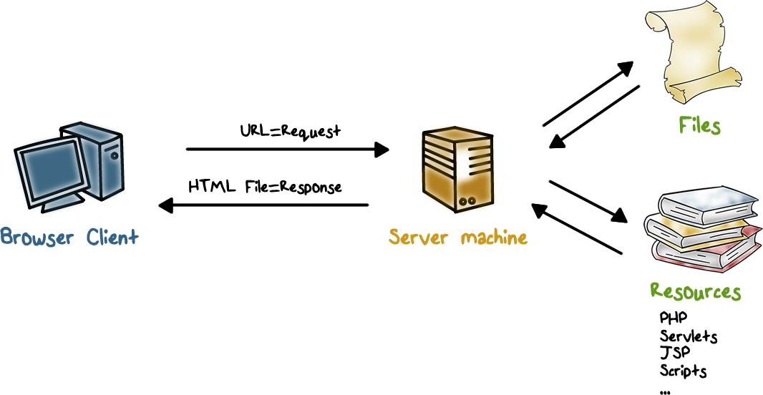
How the Web Works
The web browser and the web server communicate using HyperText Transfer Protocol (HTTP)
Browser requests “documents” (or scripts) through URL.
The Server responds with “documents” in Hyper-Text Markup Language (HTML), which can include not just text but also graphics, video/audio, postscript, JavaScript, etc.
Browsers display html documents and embedded graphics, it can run JavaScript and other helper applications.
Notes:
Let’s briefly review how the web works.

Slide 4
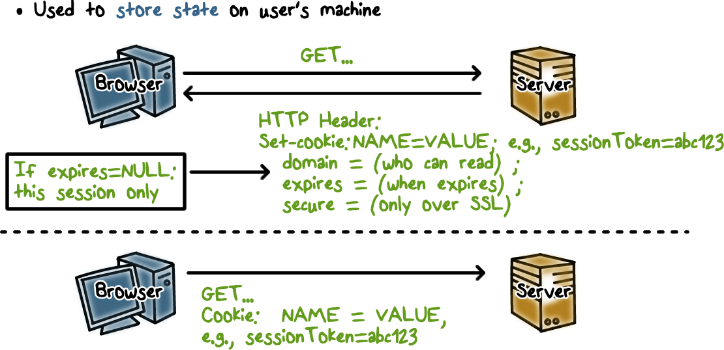
Cookies
HTTP is a stateless protocol, that is, each request is its own TCP connection. For example, if you log into your bank’s web site, each click on a URL generates a separate TCP connection. In order to carry information across multiple http requests, such as user authentication, cookies are used.
A cookie is created by the web server when the user logs into the site. It contains not only user identity information but also security information such as access, expiration time, and if SSL is required.
The user’s browser stores the cookie, and includes it in subsequent requests so that the server knows that these requests are related, for example, they belong to the same user login session.

Slide 5
Cookie Quiz
Which are true?
Cookies may be created by ads that run on websites
Cookies are created by websites a user is visiting
Cookies are compiled pieces of code
Cookies can be used as a form of virus
Cookies can be used as a form of spyware
All of the above
ANS: A, B, E
C is false, since cookies are plain text.
D is false, since cookies are not executable code like a virus
E is true, since cookies store user preferences and browsing history.
Notes:
QUIZ:
As we discussed, cookies are added to the browser directories of website visitors. So we should make sure we really understand what exactly it is we are letting onto our computers.
---
SOLUTION:
True-Cookies are created by ads, widgets, and elements on the web page the user is visiting.
True-Cookies are created by websites a user is visiting
False- cookies are not compile code. They are plaintext.
False - since cookies are not compiled code they cannot be used as a virus. They cannot replicate themselves, they cannot be executed and are not self-executing. These are all characteristics necessary to be a virus.
True- cookies can be used as spyware. Cookies store user preferences and browsing history.

Slide 6
The Web and Security
Web pages may contain dynamic contents, e.g., JavaScript
Sent from a website(s)
Run on the user’s browser/machine
Can a browser trust these contents?
In some cases, the browser can authenticate the website, but in many cases, authentication is not required.
But even if a website is authenticated, the contents that it sends may not be trustworthy because it may have security vulnerabilities that allow attackers to inject malicious content that gets passed onto the users visiting the website.
Or the website includes contents or links to other websites, which may also have security vulnerabilities.
Notes:
Let’s look at the main Web security issues.
The Browser accepts contents, and often runs dynamic contents such as scripts, from web sites. The question is:

Slide 7
The Web and Security cont’d
Websites may run applications (e.g., PHP) to generate response/page
According to requests from a user/browser
Often communicate with back-end servers
These web applications may have security vulnerabilities.
Furthermore, many websites do not authenticate users, so attackers may send requests designed to exploit security vulnerabilities.
Notes:
On the server side, a web site runs web applications that process requests from browsers, and often interacts with back-end servers to produce the contents for users.

Slide 8
Web Browser Quiz
Which are true?
Web browser can be attacked by any web site that it visits
Even if a browser is compromised, the rest of the computer is still secure
Web servers can be compromised because of exploits on web applications
ANS: A, C
B is false, since browser compromise may lead to malware installation, data theft, etc.)
C is true, e.g., website defacing, stolen credit cards
Notes:
QUIZ:
Discuss
---
SOLUTION:
1. T. 2. F (can lead malware installation, data theft, etc.) 3. T (e.g., deface sites, and back-end servers can be compromised as well, e.g., stolen credit cards)

Slide 9
Cross-Site Scripting (XSS)
Cross-Site Scripting (XSS) attacks are a type of injection, in which malicious scripts are injected into otherwise benign and trusted websites.
Notes:
If a website allows users to input content without controls, ,e.g., social networking sites, blogs, forums, then attackers can insert malicious code as well.
malicious scripts are injected into otherwise benign and trusted websites.

Slide 10
Cross-Site Scripting (XSS) cont’d
Supposr a website allows users to input data and then echos the data back, that is, include the user-input data in the html page to the user’s browser. Such websites include social networking sites, blogs, etc.
Suppose the browser sends to the site <script type=”text/javascript”>alert(“Hello World”); </script> as his “name”
The script will be included in the html page sent to the user’s browser; and when the script runs, the alert “Hello World” will be displayed
What if the script is malicious, and the browser had sent it without the user knowing about it? Then the browser would execute the malicious script.
Notes:
Suppose a website echoes user-supplied data, e.g., his name, back to user on the html page.
For example, when the user’s browser sends the user’s name to a web site, the web site echos the name back. If the browser sends a script as the name, then the script will be included in the html page and the user’s browser will execute the script.
What if the script is malicious, and the browser sent it to the web site without the user knowing about it? The browser will end up having to execute the malicious script when it is included in the html page sent back from the web site.
This can happen in a cross-site scripting attack.

Slide 11
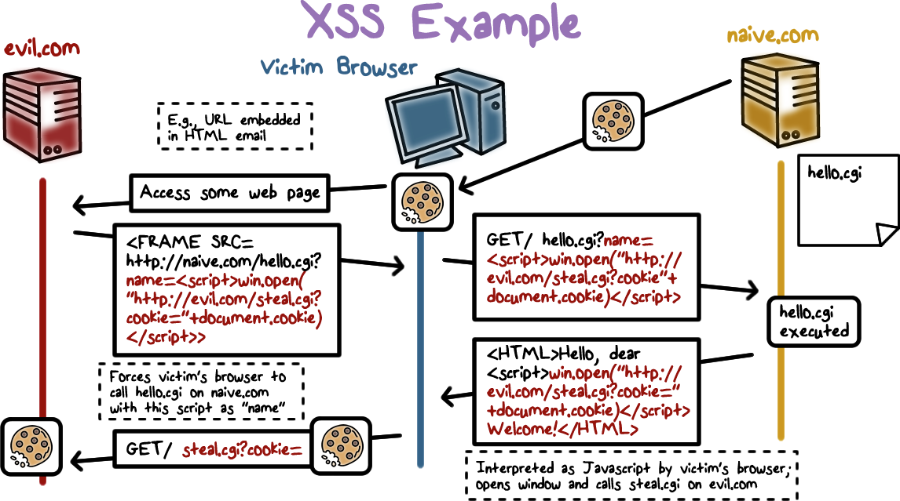
XSS Example

Slide 12
XSS Example Explanations
The user has logged into a vulnerable, trusted site naive.com and his browser now stores a cookie from naïve.com.
The user is phished and clicks a URL to visit evil.com.
evil.com returns a page that has a hidden frame that forces the browser to visit naive.com and invoke hello.cgi, with a malicious script as the “name” of the user.
hello.cgi at naive.com echoes the name, which is actually the malicious script in the html page that is sent back to the user’s browser.
The user’s browser displays the html page and executes the malicious script since it came from a trusted site naive.com, which may steal the cookie to naive.com and send it to the attacker.
So what if evil.com gets the cookie for naive.com? Cookies can include session authenticators for naive.com, that is, the attacker can now impersonate the user.
Notes:
The script is echoed back from naive.com, so the browser executes it. If the script is directly from evil.com, the browser may prevent its exedcution
https://owasp.org/www-community/attacks/xss/
Reflected XSS Attacks
Reflected attacks are those where the injected script is reflected off the web server, such as in an error message, search result, or any other response that includes some or all of the input sent to the server as part of the request. Reflected attacks are delivered to victims via another route, such as in an e-mail message, or on some other website. When a user is tricked into clicking on a malicious link, submitting a specially crafted form, or even just browsing to a malicious site, the injected code travels to the vulnerable web site, which reflects the attack back to the user’s browser. The browser then executes the code because it came from a “trusted” server. Reflected XSS is also sometimes referred to as Non-Persistent or Type-II XSS.
Stored XSS Attacks
Stored attacks are those where the injected script is permanently stored on the target servers, such as in a database, in a message forum, visitor log, comment field, etc. The victim then retrieves the malicious script from the server when it requests the stored information. Stored XSS is also sometimes referred to as Persistent or Type-I XSS.

Slide 13
XSS Query Quiz
Which are true?
When a user’s browser visits a compromised or malicious site, a malicious script is returned
To prevent XSS, any user input must be checked and preprocessed before it is used inside html (e.g., ensure that it is data, not a script)
ANS: A, B
Notes:
QUIZ:
Discuss
---
SOLUTION:
1. T. 2. T. (e.g., name should not be a script)

Slide 14
Cross-Site Request Forgery (XSRF)
Browser runs a script from a “good” site and a malicious script from a “bad” site
This can happen when the user has logged into the good site and keeps the session alive, e.g., the user has logged into Gmail, and has not logged off. Meanwhile, the user may be browsing other sites, include a bad site that sends malicious script to the browser.
Malicious script can make forged requests to “good” site with user’s cookie.
Notes:
Cross-site request forgery (XSRF) is another web-based attack.
A user’s browser may be running a script from a good site and also a malicious script from a bad site.
The malicious script can then forge a request to the good site using the user’s cookie. The good site does not know the request is not sent by the user.

Slide 15
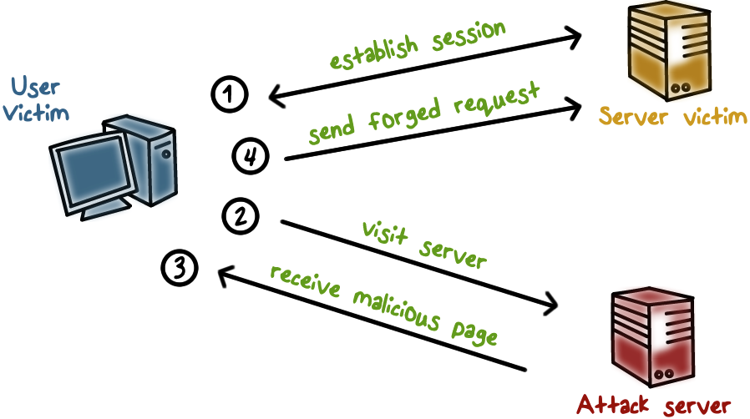
XSRF Illustration
1. User logs in and establishes a session with a good site, and keeps the session alive.
2, 3. Meanwhile, user browses a bad site, e.g., because he is phished, and the browser runs a malicious script from the bad site.
4. The malicious script then sends forged request to the good site.
Notes:
Here is an :

Slide 16
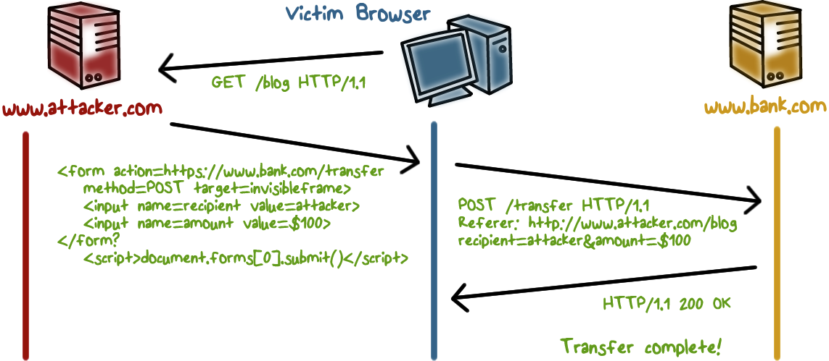
XSRF: Example
User logs into bank.com, forgets to sign off, so the Session cookie remains in browser state
User then visits a malicious website, which sends a HTML page that contains a hidden iframe that includes this malicious element:
<form name=BillPayForm
action=http://bank.com/BillPay.php>
<input name=recipient value=badguy> …
<script> document.BillPayForm.submit(); </script>
When the user’s browser displays the HTML page, actions will be performed on the Bill Payment form of the bank.com page as if the users are entering these values. Because the iframe is invisible, the user knows nothing about it. The browser will send a request on behalf of the user without his knowledge.
Since the user is still logged into bank.com, the user’s cookie is also sent to the bank along with the request. So the bank website believes the request is from the user, and fulfills the payment request.
Notes:
Here is an illustration of the example …

Slide 17
XSRF Mitigations
Checking the http Referer header to see if the request comes from an authorized page.
Use synchronizer token pattern where a token for each request is embedded by the web application in all html forms and verified on the server side.
Log off immediately after using a web application.
Do not allow browser to save username/password and do not allow web sites to “remember” user login
Do not use the same browser to access sensitive web sites and to surf the web freely

Slide 18
XSS vs. XSRF
XSS (Cross-Site Scripting) doesn't need an authenticated session and can be exploited when the vulnerable website doesn't do the basics of validating or escaping input.
CSRF (Cross-site Request Forgery) happens in authenticated sessions when the server trusts the user/browser
Notes:
Comparing XSRF and XSS …
XSS: user trusts a site, attacker injects a script to the site and it is echoed back to the user’s site, which then executes the malicious script.
XSRF: a site trusts requests are from the user, attacker forges user requests to the site, which executes the attacker’s malicious actions.
They are both the result of security weakness of web sites, in particular, the lack of authenticating and validating user input.

Slide 19
Structured Query Language (SQL)
Widely used database query language
Retrieve a set of records, e.g.,
SELECT * FROM Person WHERE Username=‘Lee’
Add data to the table, e.g.,
INSERT INTO Key (Username, Key) VALUES (‘Lee’, lfoutw2)
Modify data, e.g.,
UPDATE Keys SET Key=ifoutw2 WHERE PersonID=8
Notes:
Before we discuss SQL Injection attacks, let’s quickly review SQL.

Slide 20
Sample PHP Code
Sample PHP
$selecteduser = $_GET['user'];
$sql = "SELECT Username, Key FROM Key”.
"WHERE Username='$selecteduser'";
$rs = $db->executeQuery($sql);
What if ‘user’ is a malicious string that changes the meaning of the query?
Notes:
Nowadays, many databases have a web front-end to allow users to query the database using the Web. The website typically offers a web form for entering the query, and runs a program to form the input into an SQL query and send it to the back-end database.
The security threat here is that the input may be malicious. That is, the SQL to the database server is malicious and can lead to compromise of data confidentiality and integrity.

Slide 21
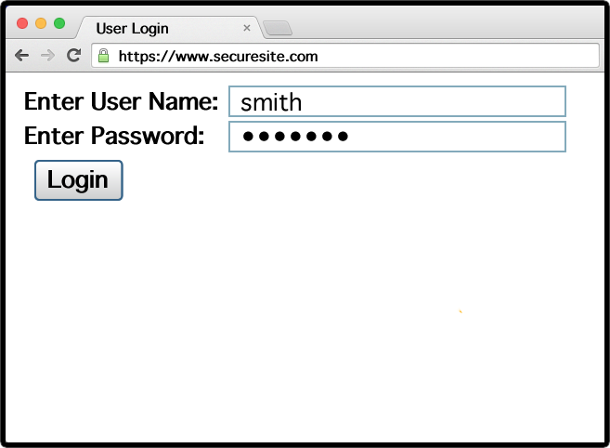
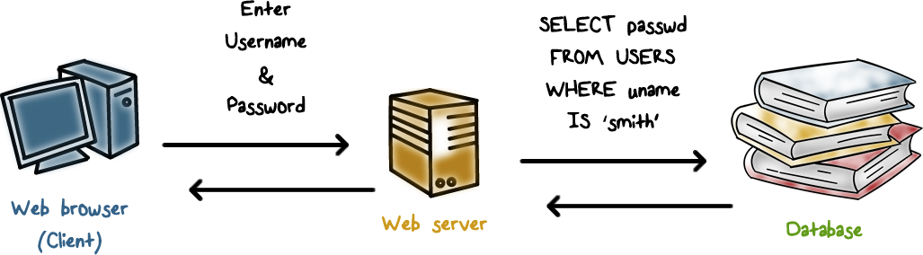
Example Login Prompt
Notes:
Here is an example of web form. A user would enter his name and password.
The password is sent in encrypted hash form to the web server, and the web server needs to retrieve the user’s password hash from the database to compare and authenticate the user. That is, the web server issues a SQL query to the database.

Slide 22
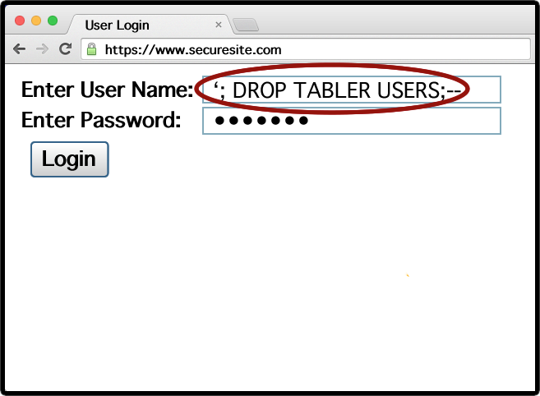
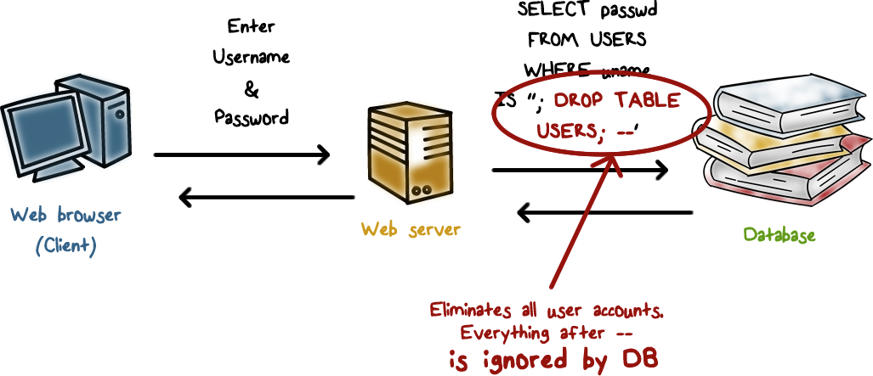
Example SQL Injection Attack
Notes:
Now suppose an attacker enters this malicious string as the user name. The actual SQL query to the backend database server is to delete all user records!

Slide 23
SQL Injection Quiz
Which is the better way to prevent SQL injection?
Use blacklisting to filter out “bad” input
Use whitelisting to allow only well-defined set of safe values
ANS: B.
A is infeasible, since there can be many possible ways to inject malicious strings.
Notes:
SOLUTION:
B. Blacklisting is hard because.

Slide 24
Summary
Both browser and servers are vulnerable: dynamic contents based on user input
XSS: attacker injects a script into a website and the user’s browser executes it
XSRF: attacker tricks user’s browser into issuing request, and the website executes it
SQL injection: attacker inject malicious query actions, and a website’s back-end db server executes the query

